Slide 1
A Guide to SQL, Ninth Edition
Chapter Two
Database Design Fundamentals
Notes:
1

Slide 2
Objectives
Understand the terms entity, attribute, and relationship
Understand the terms relation and relational database
Understand functional dependence and be able to identify when one column is functionally dependent on another
Understand the term primary key and identify primary keys in tables

Slide 3
Objectives (continued)
Design a database to satisfy a set of requirements
Convert an unnormalized relation to first normal form
Convert tables from first normal form to second normal form
Convert tables from second normal form to third normal form

Slide 4
Objectives (continued)
Create an entity-relationship diagram to represent the design of a database

Slide 5
Introduction
Database design
Process of determining the particular tables and columns that will comprise a database
Must understand database concepts
Process of normalization

Slide 6
Database Concepts
Entity
Attribute
Relationship
Functional dependence
Primary key

Slide 7
Relational Database
A collection of tables
Tables in TAL Distributors Database
Rep
Customer
Orders
Item
Order_Line

Slide 8
Entities, Attributes, and Relationships
Entity (like a noun)
A person, place, thing, or event
Attribute (like an adjective or adverb)
Property of an entity
Relationship
Association between entities

Slide 9
Entities, Attributes, and Relationships (continued)
One-to-many relationship
One rep is related to many customers
Implement by having a common column in two or more tables
REP_NUM is a column in the CUSTOMER table and the REP table
Repeating groups
Multiple entries in an individual location

Slide 10
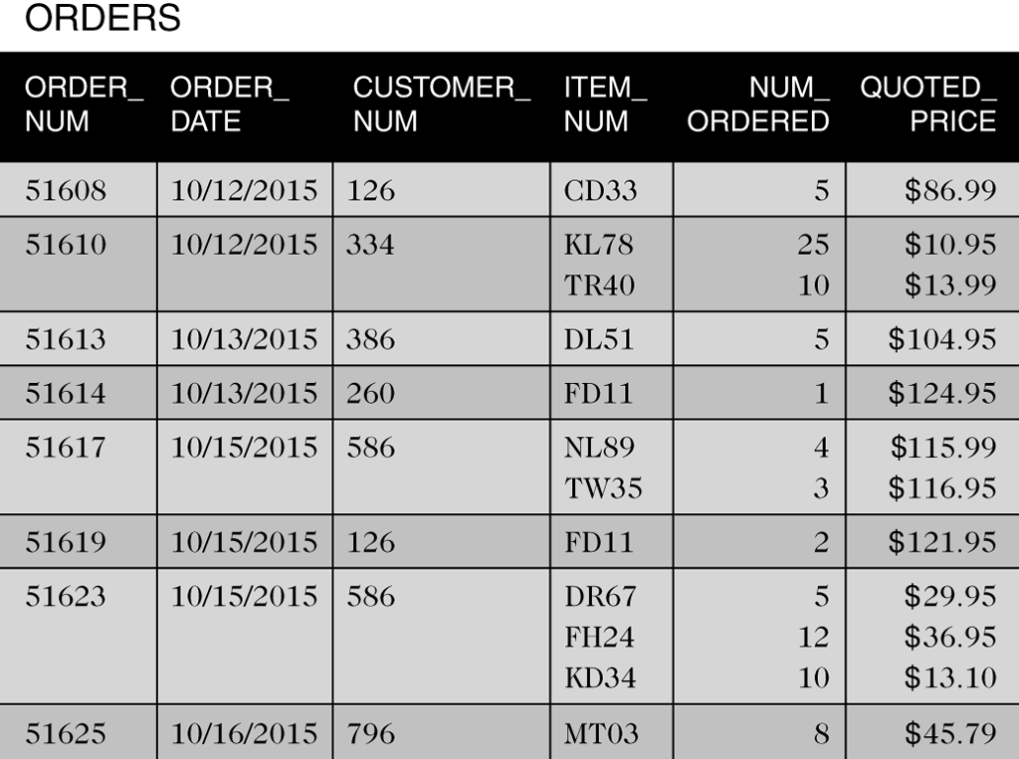
Entities, Attributes, and Relationships (continued)
Figure 2-2 Table with repeating groups

Slide 11
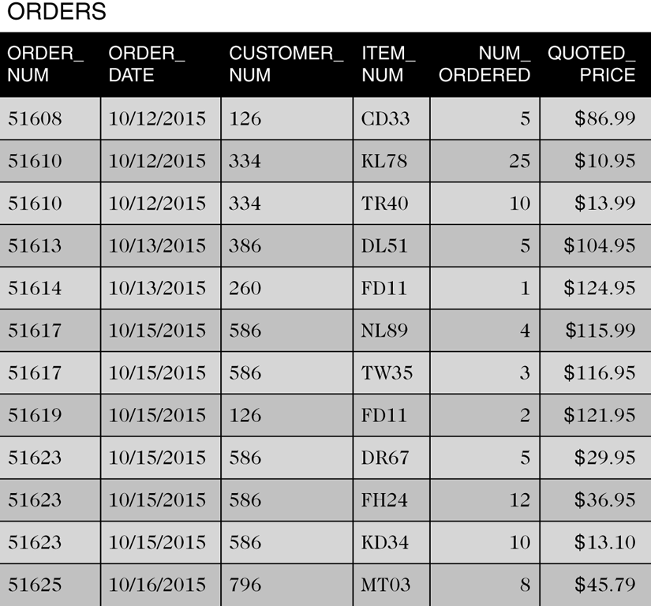
Entities, Attributes, and Relationships (continued)
Figure 2-3 ORDERS table without repeating groups

Slide 12
Entities, Attributes, and Relationships (continued)
Relation is a two-dimensional table
Entries in the table are single-valued
Each column has a distinct name
All values in a column are values of the same attribute
The order of the columns is immaterial
Each row is distinct
The order of the rows is immaterial

Slide 13
Entities, Attributes, and Relationships (continued)
Use shorthand representation to show tables and columns
REP (REP_NUM, LAST_NAME, FIRST_NAME, STREET,
CITY, STATE, POSTAL_CODE, COMMISSION, RATE)
CUSTOMER (CUSTOMER_NUM, CUSTOMER_NAME, STREET, CITY, STATE, POSTAL_CODE, BALANCE, CREDIT_LIMIT, REP_NUM)
ORDERS (ORDER_NUM, ORDER_DATE, CUSTOMER_NUM)
ORDER_LINE (ORDER_NUM, ITEM_NUM, NUM_ORDERED,
QUOTED_PRICE)
ITEM (ITEM_NUM, DESCRIPTION, ON_HAND, CATEGORY,
STOREHOUSE, PRICE)

Slide 14
Functional Dependence
An attribute, B, is functionally dependent on another attribute (or collection), A, if a value for A determines a single value for B at any one time
B is functionally dependent on A
A B
A functionally determines B
Cannot determine from sample data; must know the users’ policies

Slide 15
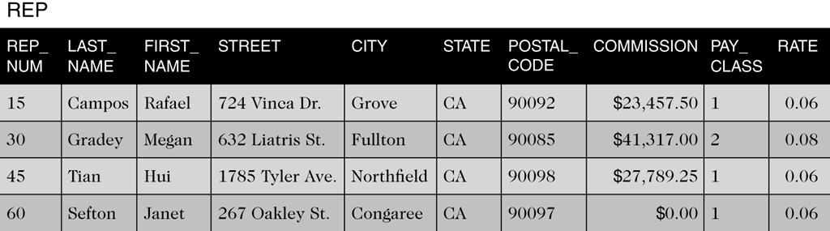
Functional Dependence (continued)
Figure 2-4 REP table with a PAY_CLASS column

Slide 16
Primary Keys
Unique identifier for a table
Column (attribute) A (or a collection of columns) is the primary key for a table (relation), R, if:
All columns in R are functionally dependent on A
No subcollection of the columns in A (assuming that A is a collection of columns and not just a single column) also has Property 1

Slide 17
Database Design
Given a set of requirements that the database must support
Requirements gathered through a process known as systems analysis

Slide 18
Design Method
Read the requirements, identify the entities (objects) involved, and name the entities
Identify the unique identifiers for the entities identified in step 1
Identify the attributes for all the entities
Identify the functional dependencies that exist among the attributes
Use the functional dependencies to identify the tables by placing each attribute with the attribute or minimum combination of attributes on which it is functionally dependent
Identify any relationships between tables.

Slide 19
Database Design Requirements
For TAL Distributors
Must store data about sales reps, customers, items, orders, and order lines
Must enforce certain constraints; for example:
There is only customer per order
On a given order, there is at most one line item for a given item
The quoted price may differ from the actual price

Slide 20
Database Design Process Example
Apply requirements to six steps in design method

Slide 21
Normalization
Identify the existence of potential problems
Provides a method for correcting problems
Goal
Convert unnormalized relations (tables that contain repeating groups) into various types of normal forms

Slide 22
Normalization (continued)
1 NF
Better than unnormalized
2 NF
Better than 1 NF
3 NF
Better than 2 NF

Slide 23
First Normal Form
A relation is in first normal form (1NF) if it does not contain any repeating groups
To convert an unnormalized relation to 1NF, expand the PK to include the PK of the repeating group
This effectively eliminates the repeating group from the relation

Slide 24
Second Normal Form
Redundancy causes problems
Update Anomalies
Update
Inconsistent data
Additions
Deletions

Slide 25
Second Normal Form (continued)
A relation is in second normal form (2NF) if it is in 1NF and no nonkey attribute is dependent on only a portion of the primary key
or …
All nonkey attributes are functionally dependent on the entire primary key

Slide 26
Second Normal Form (continued)
A 1NF relation with a primary key that is a single field is in 2NF automatically

Slide 27
Third Normal Form
Update anomalies still possible
Determinant
An attribute (or collection) that functionally determines another attribute

Slide 28
Third Normal Form (continued)
A relation is in third normal form (3NF) if it is in 2NF and the only determinants it contains are candidate keys
Boyce-Codd normal form (BCNF) is the true name for this version of 3NF

Slide 29
Diagrams for Database Design
Graphical illustration
Entity-relationship (E-R) diagram
Rectangles represent entities
Arrows represent relationships

Slide 30
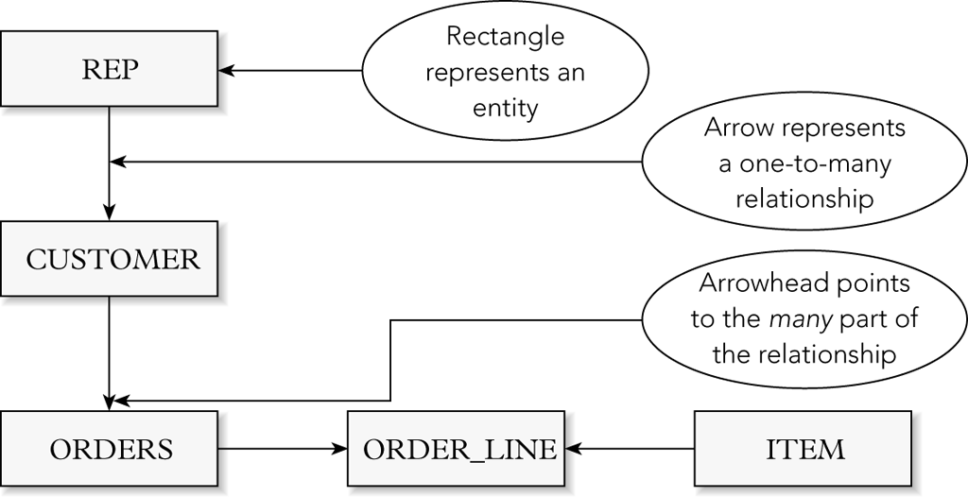
Diagrams for Database Design (continued)
Figure 2-13 E-R diagram for the TAL Distributors database with rectangles and arrows

Slide 31
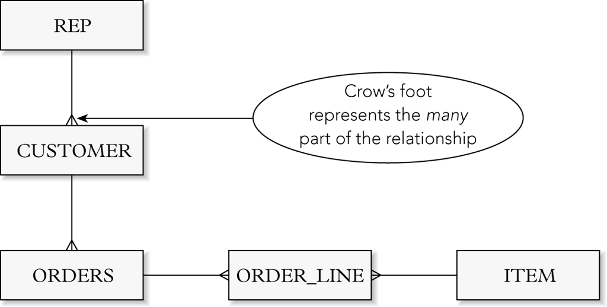
Diagrams for Database Design (continued)
Figure 2-14 E-R diagram for the TAL Distributors database with a crow’s foot

Slide 32
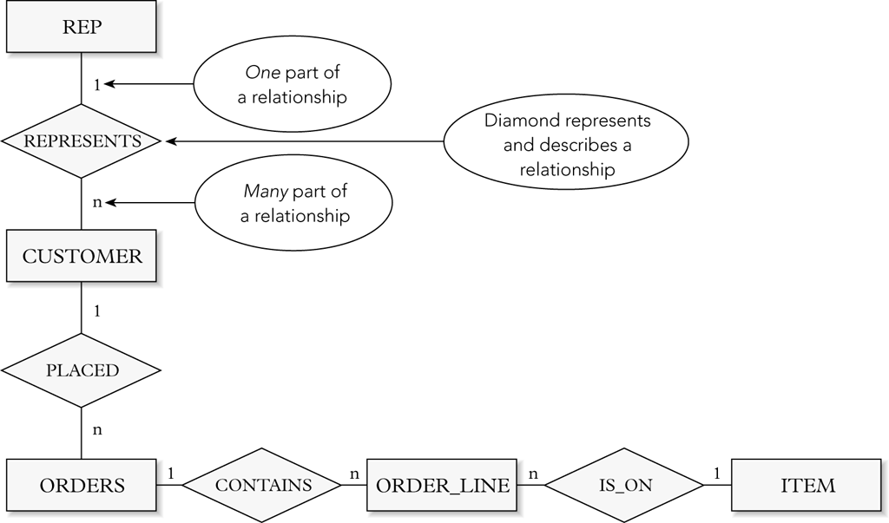
Diagrams for Database Design (continued)
Figure 2-15 E-R diagram for the TAL Distributors database with named relationships

Slide 33
Summary
Definition of entity
Definition of attribute
Definition of relationship
Definition of relation
Definition of functional dependence
Definition of primary key
Database design method

Slide 34
Summary (continued)
Normalization
Unnormalized (repeating groups)
First normal form (INF)
Second normal form (2NF)
Third normal form (3NF)
Entity-relationship diagram (E-R diagram)

